Slide 1
Understanding AI Problems Related to Supervised/Unsupervised Learning
Notes:
The name of the section would be mentioned here.

Slide 2
In this Section, we are going to take a look at…
What is Machine Learning
Why do we need Machine Learning
What is Supervised Learning
What is Unsupervised Learning

Slide 3
What is Machine Learning
Notes:
[Mandatory Slide] This would be the introduction slide of the topic that you are covering in this subsection.
When this slide plays, you could talk about the main aim that we’d be covering in this video.

Slide 4
What is Machine Learning?
Capability of machine to add new knowledge or refine previous knowledge to make optimum decisions.
Herbert Simon: “Learning is any process by which a system improves performance from experience.”
A computer program is said to learn from experience E with respect to some class of tasks T and performance measure P, if its performance at tasks in T, as measured by P, improves with experience E
Tom Mitchell
Notes:
This slide, like mentioned above is for multiple pointers. The information above covers the types of information that can be used in this slide

Slide 5
Why?
Develop systems that are too difficult/expensive to construct manually because they require specific detailed skills or knowledge tuned to a specific task (knowledge engineering bottleneck).

Slide 6
Learning Model
(Data + Labels)
Environment
or
Teacher
Stimuli
Examples
Feedback
Learner
Component
Knowledge Base
Performance
Evaluator
Performance
Component
Response
Tasks

Slide 7
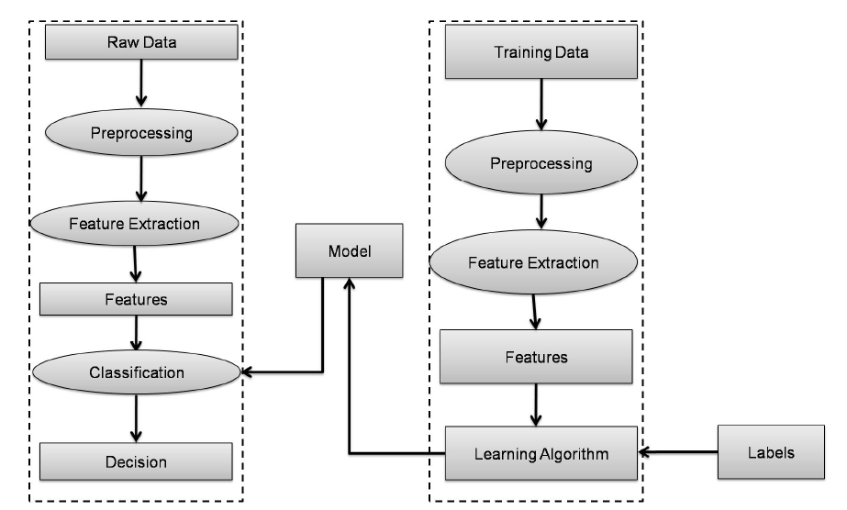
Supervised Learning

Slide 8
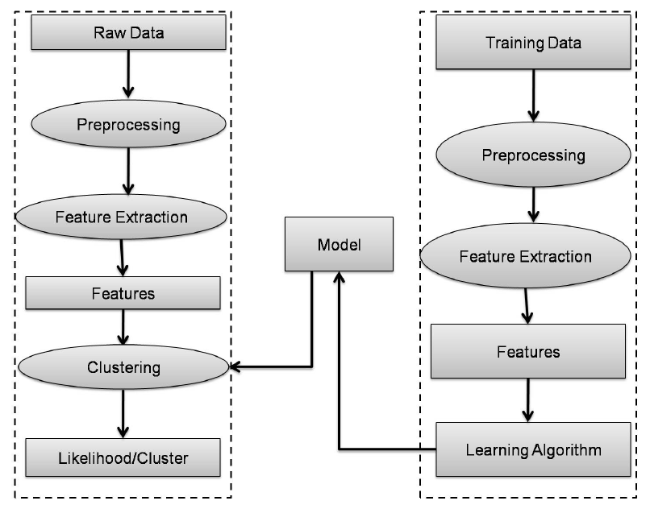
Unsupervised Learning

Slide 9
Next Video
Difference Between Classification and Regression
Notes:
[Mandatory Slide]
Here the name of the next video needs to be mentioned. The narration as you guessed it would be just letting the viewer know exactly where we are at and what we’d be taking over next! ☺

